Slide 1
Nonlinear Noise2Noise
for Efficient Monte Carlo
Denoiser Training
Andrew Tinits & Stephen Mann
University of Waterloo

Slide 2



Supervised Learning
$$L(\tilde{y},y)$$
$$y$$
$$\tilde{y}$$
Notes:
We’ll start by showing a supervised regression problem in one dimension
This could represent the value of one color channel of one pixel in an image, for example
Here we show a distribution of target values, and a particular target value y
* For a particular training example, our model might output the estimate y tilde
* This estimate is compared to the target value y with a loss function L
* And the model parameters are then updated to minimize this loss function

Slide 3





Noise2Noise [Lehtinen et al. 2018]
$$L(\tilde{y},\hat{y})$$
$$\hat{y}$$
$$y=𝔼[\hat{y}]$$
$$\hat{y}$$
$$\tilde{y}$$
Notes:
But clean targets can be expensive to obtain, like with Monte Carlo rendered images
With Noise2Noise, the clean targets y are replaced with noisy targets y hat, which are easier to obtain
The clean target y is now the mean of the noisy targets y hat
And the estimate is the same as long as the noise has zero mean
For a particular training example, our model again outputs an estimate y tilde
Note that the majority of the probability mass now lies towards the mean
* So we’ll likely get a noisy target y hat in that direction
The estimate y tilde is then compared to the noisy target y hat with the loss function L
* And the model parameters are then updated to move the estimate y tilde towards the noisy target y hat
On average, this will also move the estimate y tilde towards the clean target y

Slide 4






Noise2Noise with Nonlinearity
$$φ(\hat{y})$$
$$φ$$
$$𝔼[φ(\hat{y})]$$
$$φ(𝔼[\hat{y}])$$
$$\hat{y}$$
$$y=𝔼[\hat{y}]$$
Notes:
Let’s start again with the Noise2Noise setup from the previous slide
What happens if we preprocess the noisy targets using a nonlinear function phi?
Nonlinear functions are common in image processing, such as tone mapping for example
On the vertical axis, we show the image of the noisy target distribution after applying the phi function
Note that this phi function stretches the distribution away from the origin
Since the distribution is stretched, the mean of the image distribution (on the vertical axis) will be different from the image of the original mean
* Since the means are different, we will no longer get the correct estimate, i.e. the results will be skewed

Slide 5
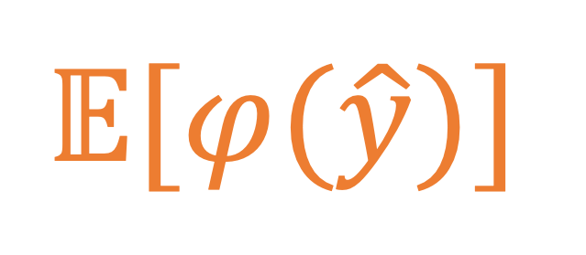


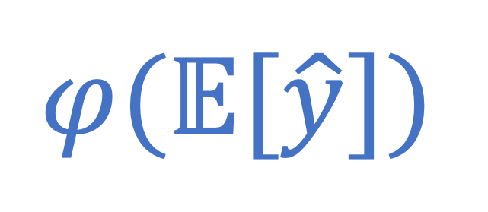
Jensen Gap
$$𝔼[φ(\hat{y})]$$
$$≠$$
$$φ(𝔼[\hat{y}])$$
$$−$$
Jensen Gap [Jensen 1906]
Notes:
So the means are different, does that mean that we can’t use nonlinear functions on the noisy targets?
That’s what was previously believed
But our main idea is that we can measure the difference between these means
This quantity is known as the Jensen Gap
By ensuring that the Jensen Gap is small, we can apply nonlinear functions to the noisy targets without adding significant bias to the results

Slide 6

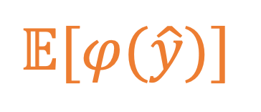



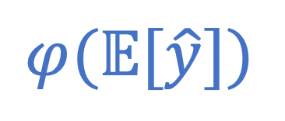
Bounding the Jensen Gap
$$J(y)Var(\hat{y})$$
$$≤$$
$$𝔼[φ(\hat{y})]$$
$$−$$
$$φ(𝔼[\hat{y}])$$
$$≤$$
$$J(y)Var(\hat{y})$$
[Liao and Berg 2019]
Notes:
To bound the Jensen Gap, we use the method of Liao and Berg [2019]
The only requirement of this method is that phi is twice differentiable
You can see that the lower and upper bounds both have the form J(y) times the variance of the noisy targets y-hat
J(y) is a function of the clean target y that is related to the curvature of the nonlinear function phi
So how do we make sure that this bound is small?
The bound will be small when the variance is small, but this is hard to achieve in practice
The bound is also small when phi is nearly linear around the clean target y, so we can choose a phi function to meet this requirement
It also turns out that, for bounded distributions, the variance will be small near the min/max values [Bhatia and Davis 2000]
Phi can therefore have some curvature near the min/max values as well

Slide 7
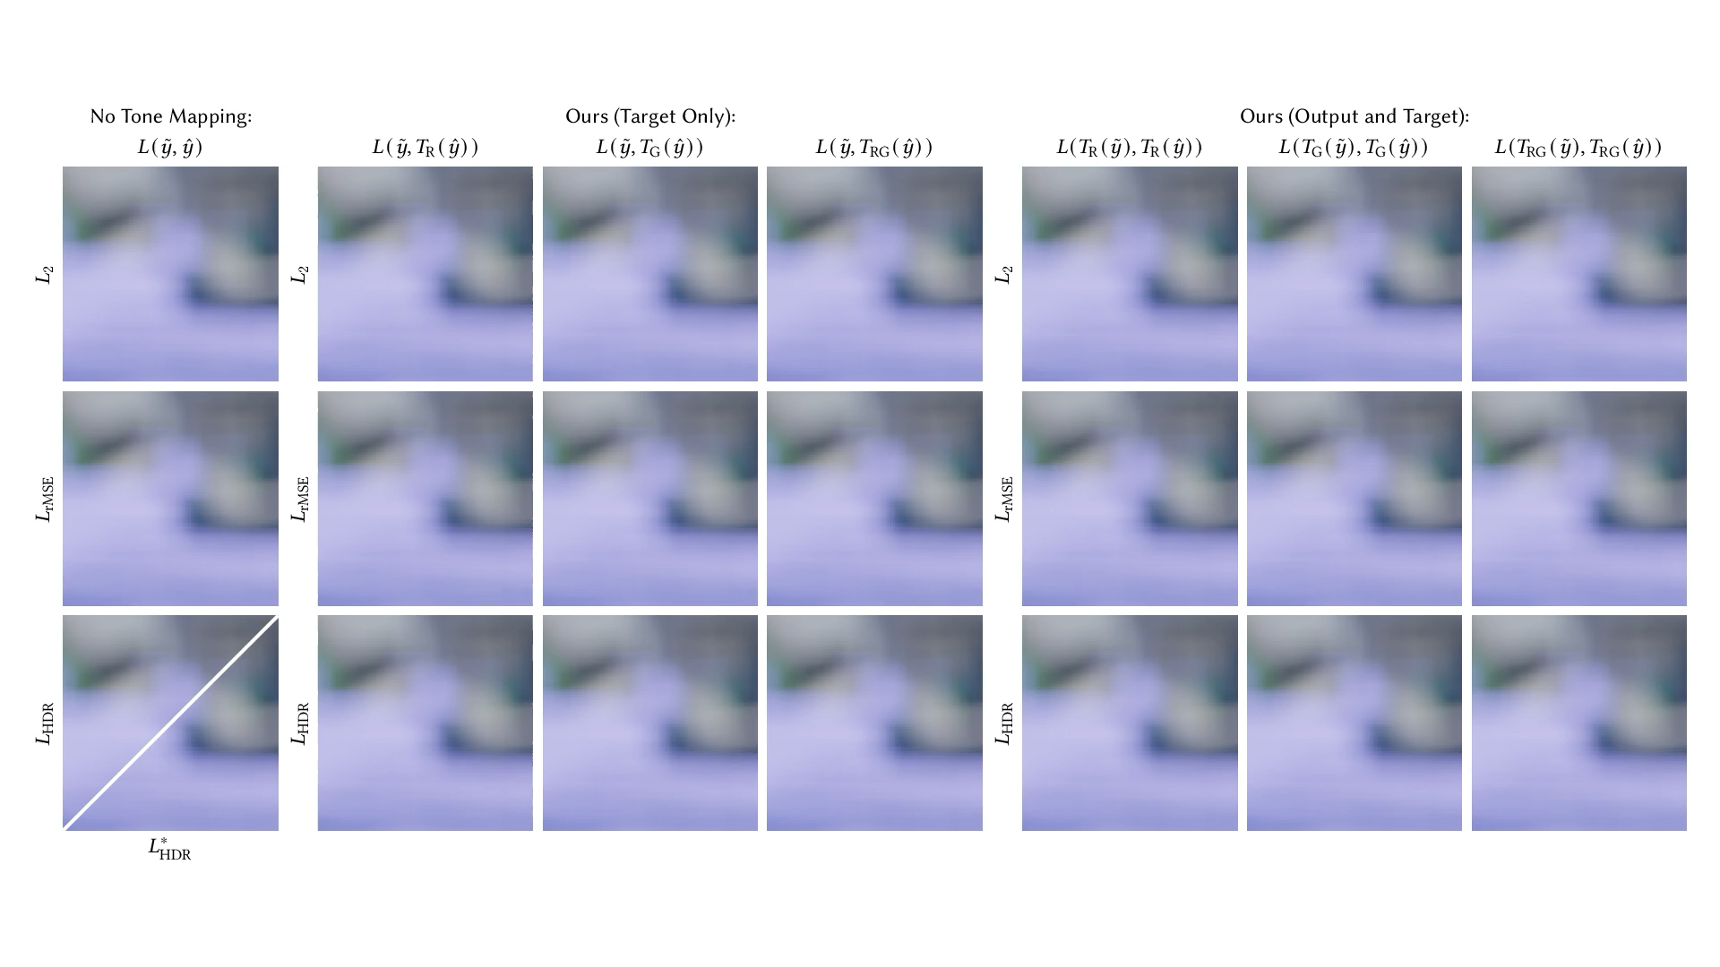
Model Selection
Notes:
To evaluate our method, we applied it to a Monte Carlo denoising task
Noise2Noise training can have trouble with HDR images, where the loss is overwhelmed by outliers and the training performs poorly
We apply our theoretical framework to show that certain combinations of loss functions and tone mapping functions can address this problem while introducing minimal bias
Here we train denoising models using 22 different combinations of loss functions, tone mapping functions, and tone mapping placement
Our models with tone mapping of both the model output and the target images performed best, matching our theoretical predictions

Slide 8
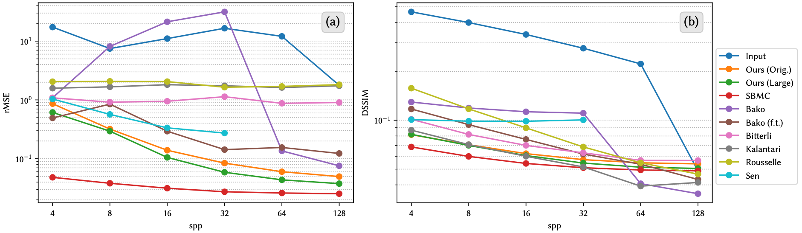
Comparing to Clean References
Notes:
We also compared our method to training with clean reference images
Training with clean references is represented by the original SBMC implementation
Our method is represented by the best performing configuration from the previous slide
We also included another version of our model trained on twice as much noisy data
We include other comparison methods using numbers from the SBMC paper
These models were evaluated on the SBMC test set, which consists of 55 publicly available scenes
Here we show relative MSE and DSSIM error metrics, where lower values are better for both
Our models produced results that are close to SBMC for all sample counts in terms of DSSIM
Our results are close for relative MSE at high sample counts, and about an order of magnitude larger at lower sample counts

Slide 9
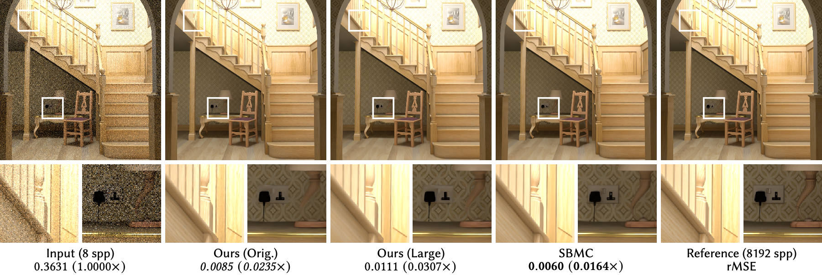
Comparing to Clean References
(The Wooden Staircase by Wig42, CC BY 3.0)
Notes:
Here we show outputs from our models and SBMC on a single test scene
From left to right, we have the noisy input rendered at 8 spp, the output of our models, the output of SBMC, and the reference image rendered at 8192 spp
Our models compare well to SBMC, with all three models reducing the relative MSE of the noisy input to a single-digit percentage of its original value

Slide 10
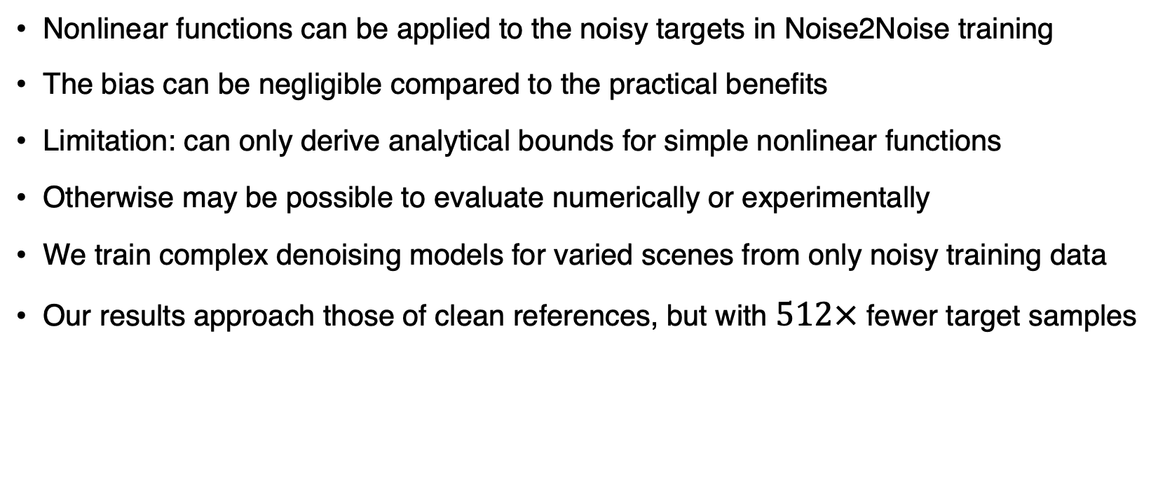
Conclusions
Nonlinear functions can be applied to the noisy targets in Noise2Noise training
The bias can be negligible compared to the practical benefits
Limitation: can only derive analytical bounds for simple nonlinear functions
Otherwise may be possible to evaluate numerically or experimentally
We train complex denoising models for varied scenes from only noisy training data
Our results approach those of clean references, but with $512×$ fewer target samples

